Slide 1
Browser Forensics
The Data Source and some questions are adapted from NCL 2017

Slide 2
Introduction

Slide 3
What is web browser
A web browser (commonly referred to as a browser) is a software application for accessing information on the World Wide Web (wiki).

Slide 4
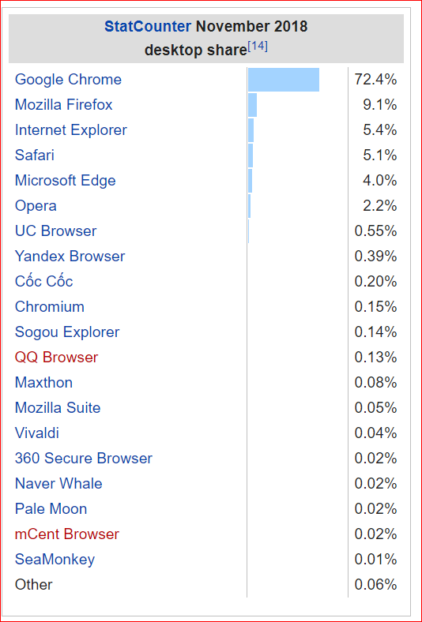
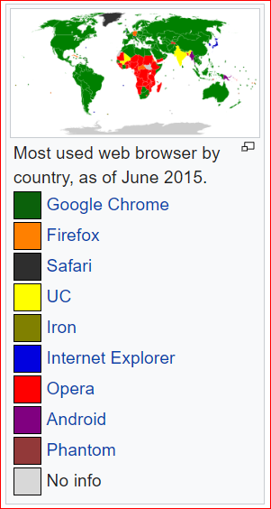
Market share

Slide 5
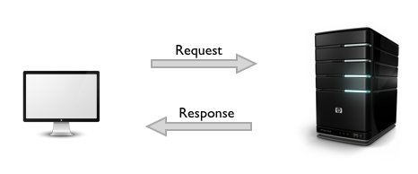
URL
Each individual web page, image, and video is identified by a distinct Uniform Resource Locator (URL) , enabling browsers to retrieve and display them on the user's device.

Slide 6
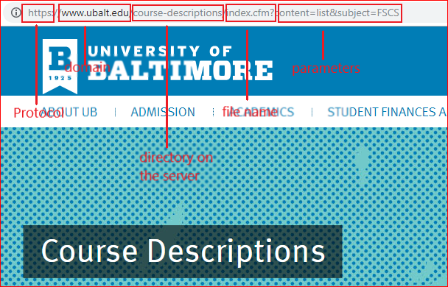

Slide 7
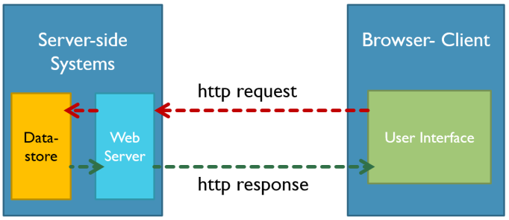

Slide 8
What evidence will browser save?

Slide 9
Internet Explorer
Temporary Files
C:\Users\<user>\AppData\Local\Microsoft\Windows\Temporary Internet Files
The cookies

Slide 10
Firefox
default location
C:\Users\<user>\AppData\Roaming\Mozilla\Firefox\Profiles\<profile folder>
Cache
about:cache in the address bar
cookies.sqlite
downloads.sqlite
places.sqlite
a record of visited pages
bookmarks, favorite icons, input history, keywords, and browsing history

Slide 11
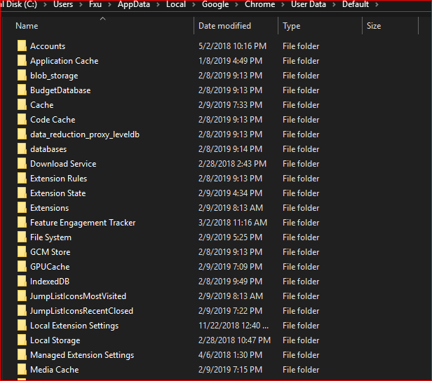
Google Chrome
Location
C:\Users\<user>\AppData\Local\Google\Chrome\User Data\
Contains
Browser cache
Cookies
Plugin data
History
More details
https://chromium.googlesource.com/chromium/src/+/HEAD/docs/user_data_dir.md#Windows

Slide 12
Log Analysis

Slide 13
Firefox Log acquisition

Slide 14
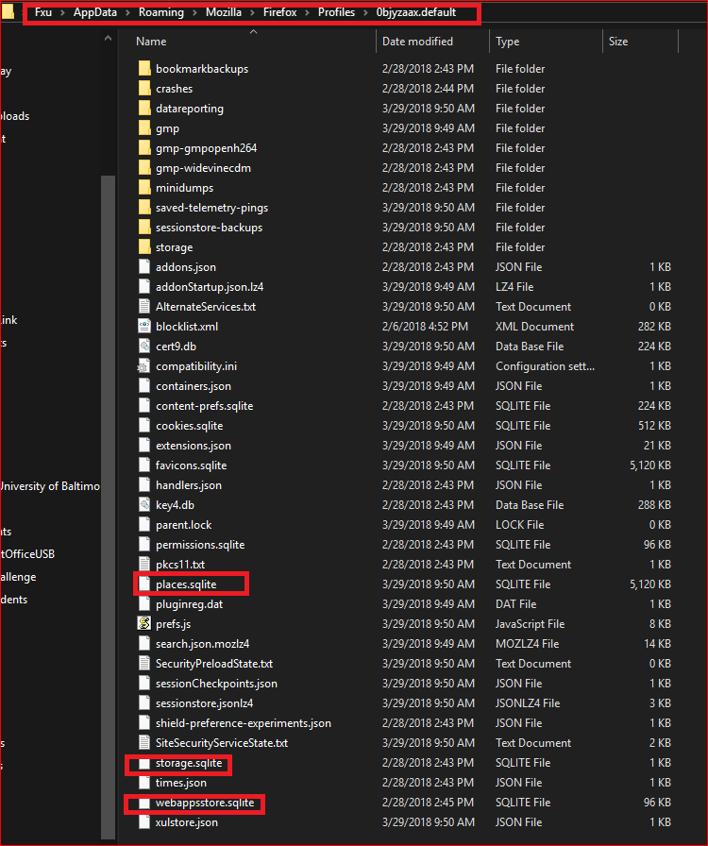

Slide 15
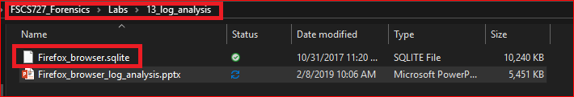
Logs used in this lab
Data Source: NCL 2017

Slide 16
Goal of the lab
A suspect used bitcoin for money laundry
Your task is to find evidence in the suspect’s browser (Firefox).

Slide 17
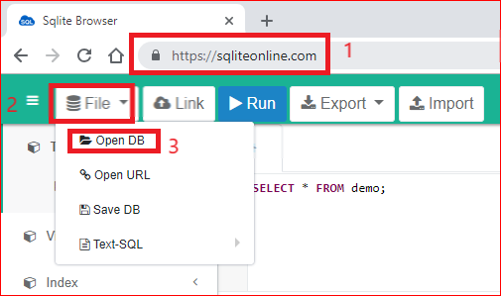
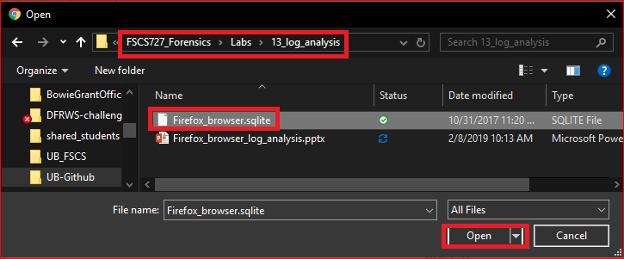
Open Firefox logs

Slide 18
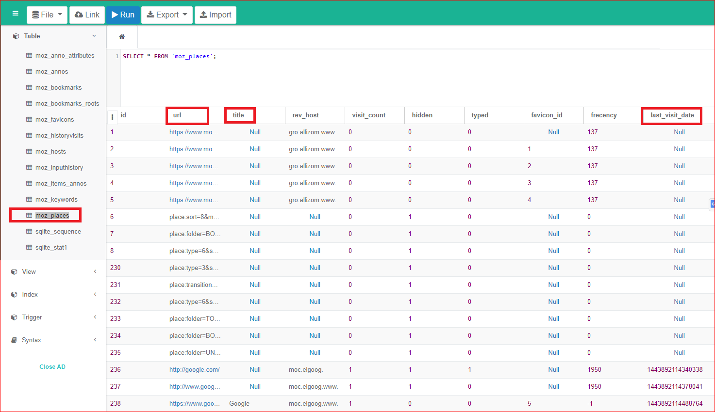

Slide 19
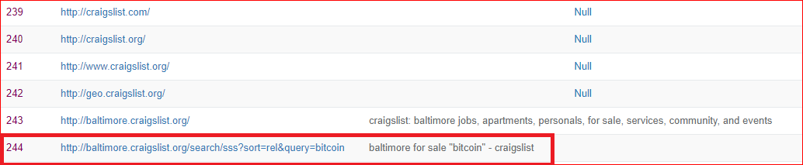
What item did the user search for on craigslist?
It seems the user lived in Baltimore. Why?

Slide 20
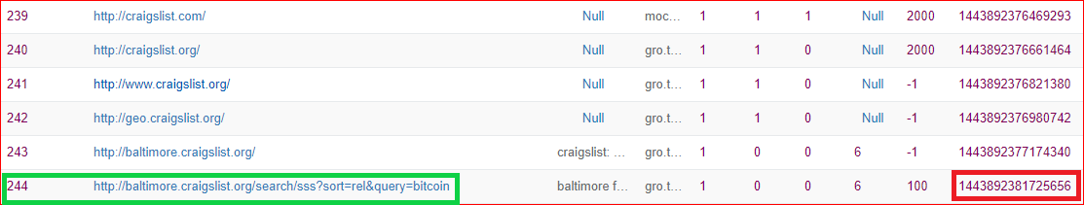
When did the user search the item?
UNIX Epoch time:
It is the number of seconds that have elapsed since 00:00:00 Thursday, 1 January 1970
How to convert Epoch time to Date/Time?

Slide 21
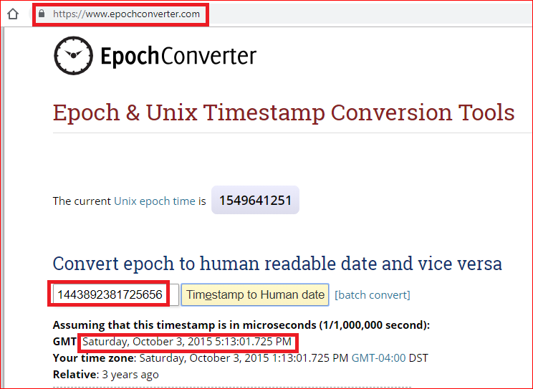

Slide 22
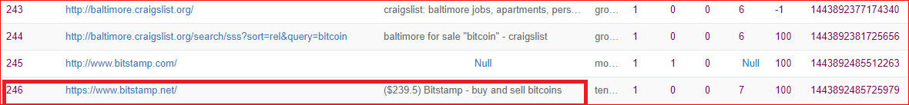
What was the current price of bitcoin when the user was browsing?

Slide 23
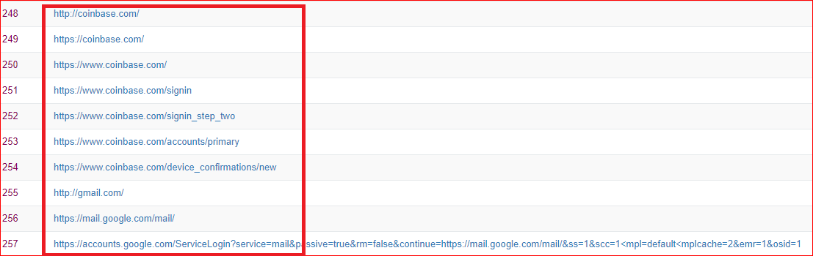
What Bitcoin exchange did the user log in to?

Slide 24
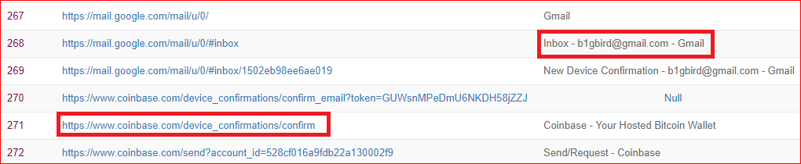
What is the email that was used to log into the exchange?

Slide 25
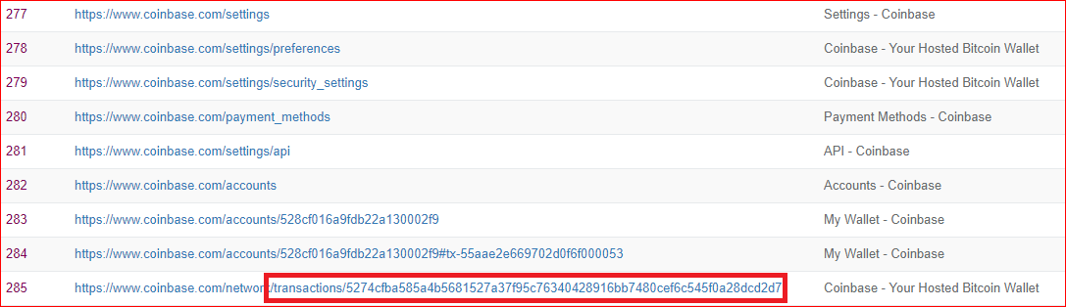
What was the ID of the Bitcoin transaction that the user looked at?

Slide 26
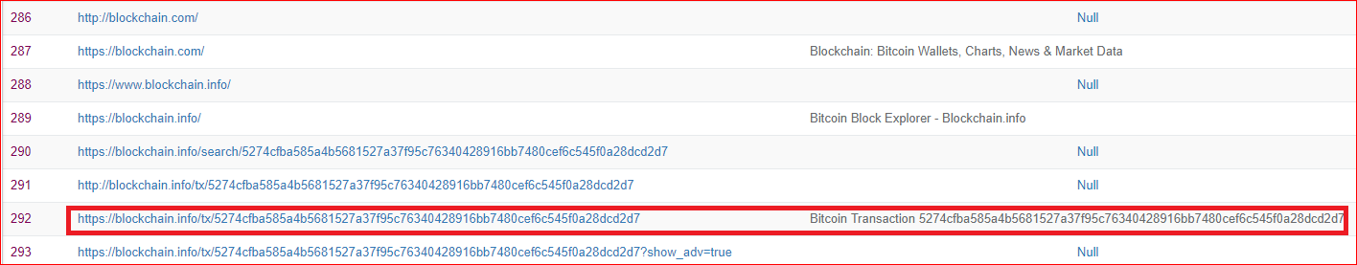
What was the total value of all the inputs of the Bitcoin transaction?

Slide 27
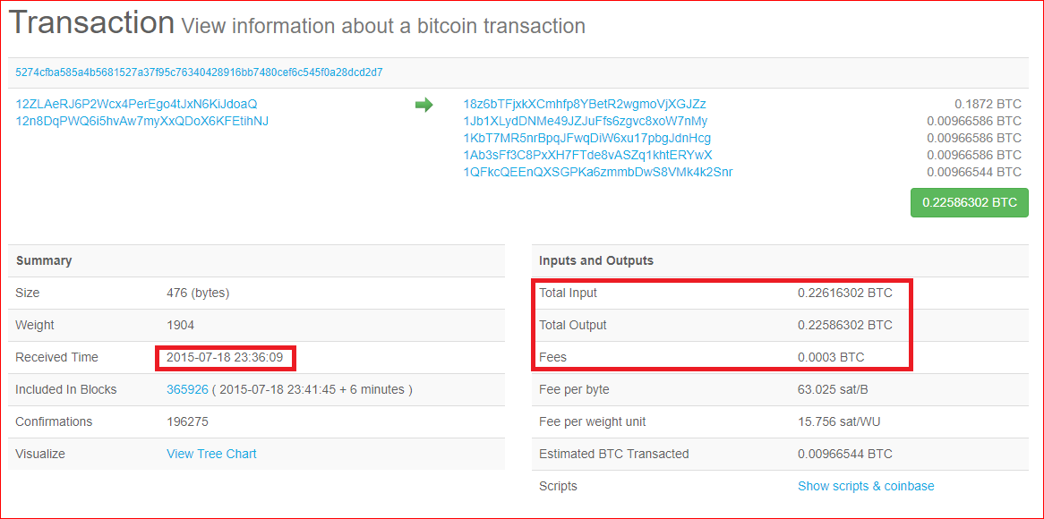

Slide 28
Your work
Write a report
When
Where
What
Who
Which tool has you used?

Slide 29
Reference
http://sci.tamucc.edu/~cams/projects/345.pdf

